Slide 1
Data Structures & Algorithms (CSC-214)
Lec 5: Array Sorting

Slide 2
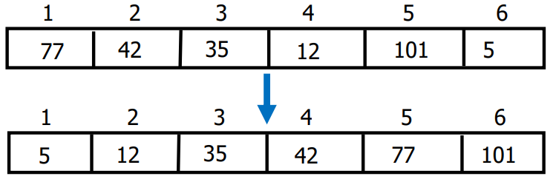
Sorting
Sorting takes an unordered collection and makes its an ordered one
Ascending order
Descending order

Slide 3
Sorting Algorithms
Bubble sort
Selection sort
Insertion sort
Merge sort
Quick sort (very efficient method for most applications)

Slide 4
Bubble Sort

Slide 5
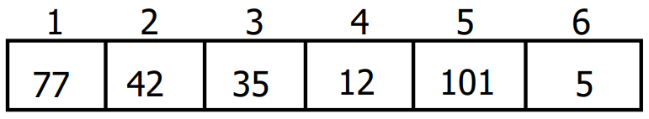
Idea: Bubbling Up the Largest Element
Traverse a collection of elements
Move from the front to the end
“Bubble” the largest value to the end using the operations
Pair-wise comparison
Swapping

Slide 6
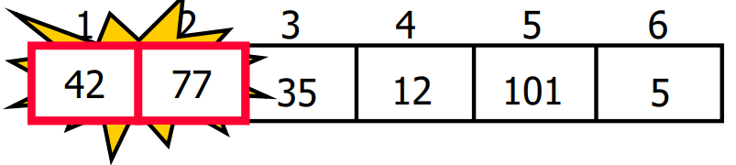
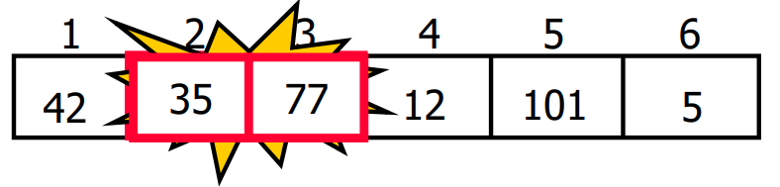
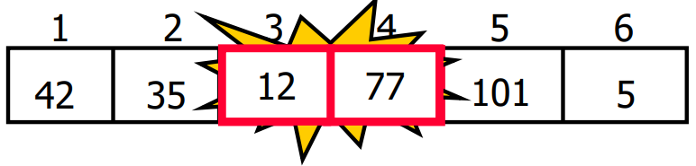
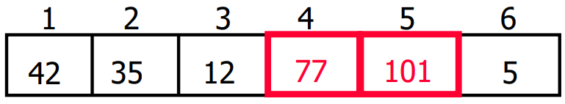
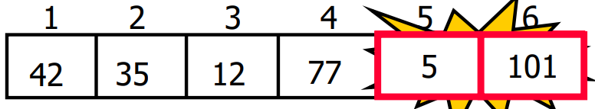
Idea: Bubbling Up the Largest Element
Traverse a collection of elements
Move from the front to the end
“Bubble” the largest value to the end using the operations
Pair-wise comparison
Swapping

Slide 7
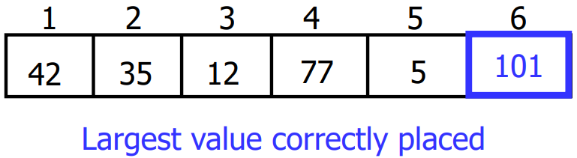
Repeat “Bubble Up”
Notice that only the largest value is correctly placed
All other values are still out of order
We need to repeat this process ,i.e., repeat “bubble up”

Slide 8
How Many Times to Repeat “Bubble Up”
Each time we bubble an element, we place it in its correct location
If we have n elements…
How many times will we need to repeat the “bubble up” process?

Slide 9
How Many Times to Repeat “Bubble Up”
Each time we bubble an element, we place it in its correct location
If we have n elements…
How many times will we need to repeat the “bubble up” process?
n – 1 times

Slide 10
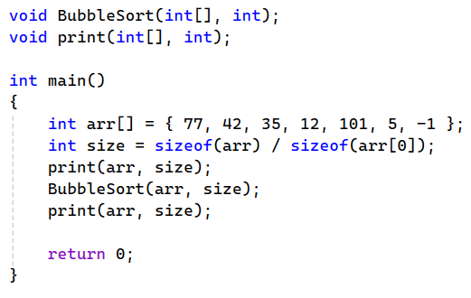
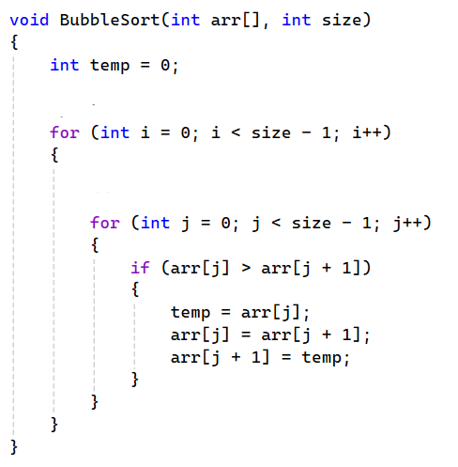

Bubble Sort Algorithm

Slide 11
Bubble Sort Algorithm
Q1: what is the purpose of the outer loop?
Q2: why is the outer loop condition, I < size – 1?
Q3: what is the purpose of the inner loop?
Q4: why is the inner loop condition, j < size – 1?

Slide 12
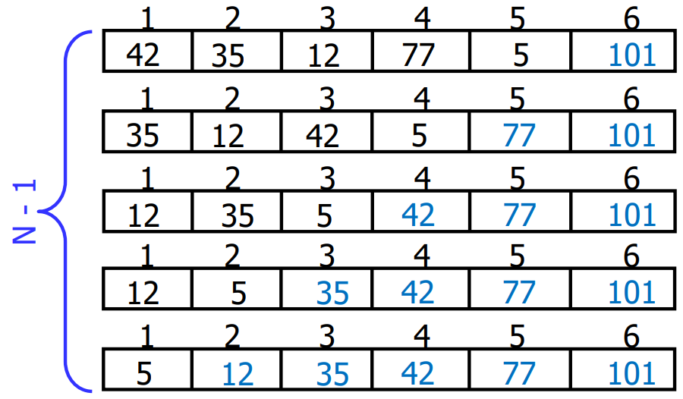
“Bubbling” All the Elements

Slide 13
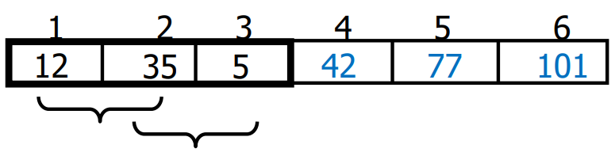
Reducing Number of Comparisons
Notes:
On the k th “bubble up”, we only need to do SIZE - k comparisons
Example
This is the 4th “bubble up”
SIZE of the array is 6
Thus, we have 2 comparisons to do

Slide 14
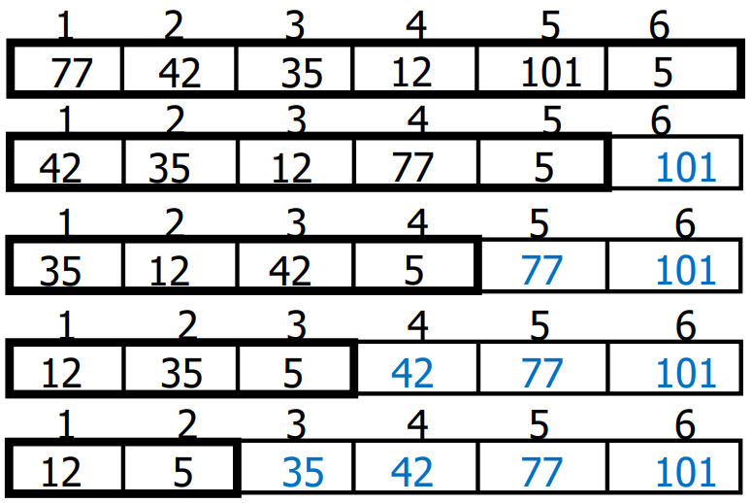
Reducing Number of Comparisons

Slide 15
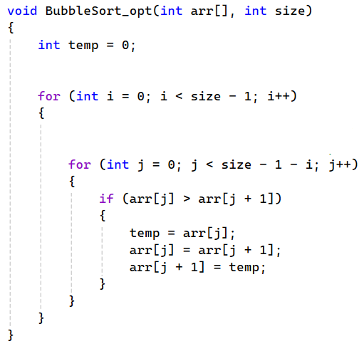
Reducing Number of Comparisons
Q1: how many times will the outer loop run?
Q2: how many times will the inner loop run when i = 2? (size: 6)
Q3: why is the inner loop condition, j < size – 1– i?
Notes:
Q1: size – 1 passes
Q2: 0 -> (size – pass) steps

Slide 16
Already Sorted Elements
What if the elements were already sorted?
What if only a few elements are out of place and after a couple of “bubble ups”, the collection is sorted?
We want to be able to detect this and “stop early”!

Slide 17
Already Sorted Elements
Using a Boolean Flag
We can use a boolean variable to determine if any swapping occurred during the “bubble up”
If no swapping occurred, then we know that the collection is already sorted!
This boolean “flag” needs to be reset after each “bubble up”

Slide 18
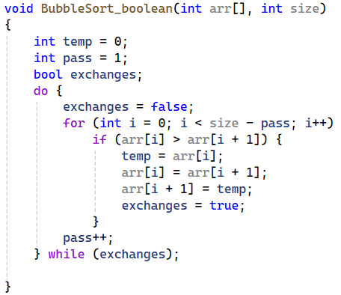
Already Sorted Elements

Slide 19
Bubble Sort Drawbacks
The bubble sort algorithm is simple, but it is inefficient because values move by only one element at a time toward their final destination in the array
Slower and computationally expensive with larger arrays

Slide 20
Selection Sort

Slide 21
Selection Sort
Define the entire array as the unsorted portion of the array
While the unsorted portion of the array has more than one element:
Find its largest element
Swap with last element (assuming their values are different)
Reduce the size of the unsorted portion of the array by 1.

Slide 22
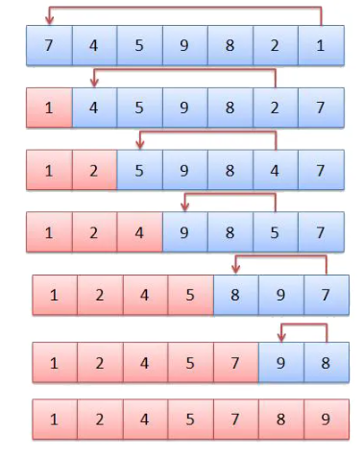
Selection Sort - Example

Slide 23
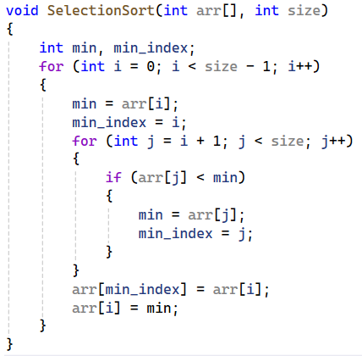
Selection Sort Algorithm
Q: Do we need a temp variable to exchange values?

Slide 24
Selection Sort vs. Bubble Sort
The bubble sort is inefficient for large arrays
Items only move by one element at a time
The selection sort moves items immediately to their final position
Makes fewer exchanges

Slide 25
Selection Sort vs. Bubble Sort
Comparison for the worst-case scenario
Number of Comparisons?
Number of Swaps?
Space complexity

Slide 26
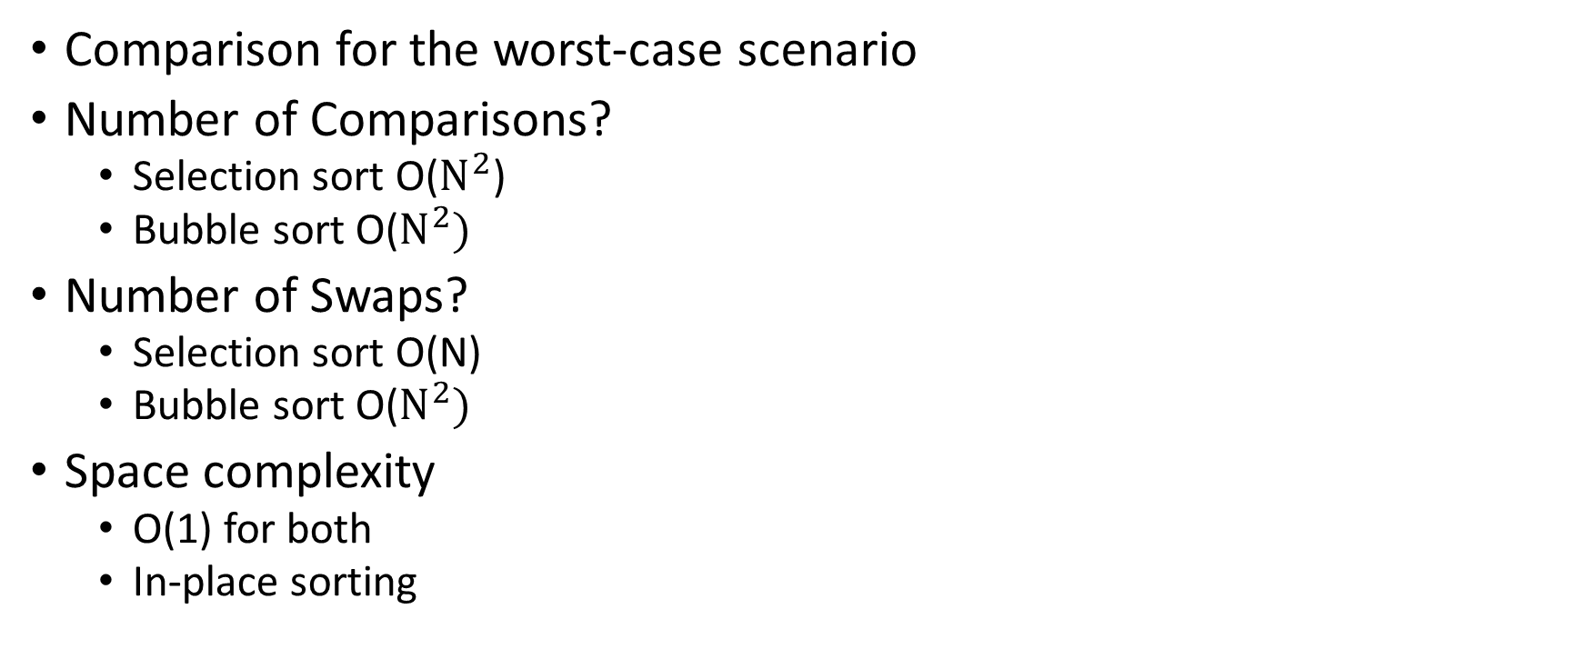
Selection Sort vs. Bubble Sort
Comparison for the worst-case scenario
Number of Comparisons?
Selection sort O($N^{2}$)
Bubble sort O($N^{2})$
Number of Swaps?
Selection sort O(N)
Bubble sort O($N^{2})$
Space complexity
O(1) for both
In-place sorting

Slide 27
Sorting characters and strings
Lexicographical Ascending Order (Alphabetical Order)
Words or strings are arranged based on dictionary order.
Example: "apple", "banana", "grape", "mango", "orange"
For single characters: 'A', 'B', 'C', ..., 'Z' (uppercase first) 'a', 'b', 'c', ..., 'z' (lowercase after uppercase)
For numbers as strings: "10", "100", "2", "25", "5" (Here, "10" comes before "2" because strings are compared character by character.) (since '1' < '2' in ASCII comparison)

Slide 28
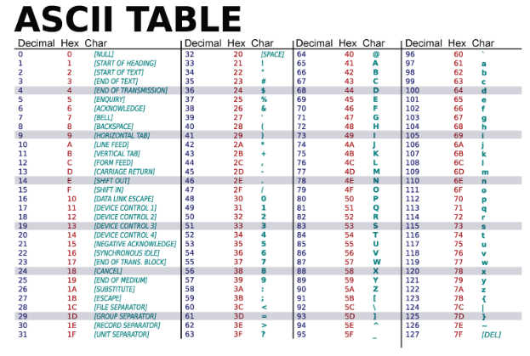
Sorting characters and strings

Slide 29
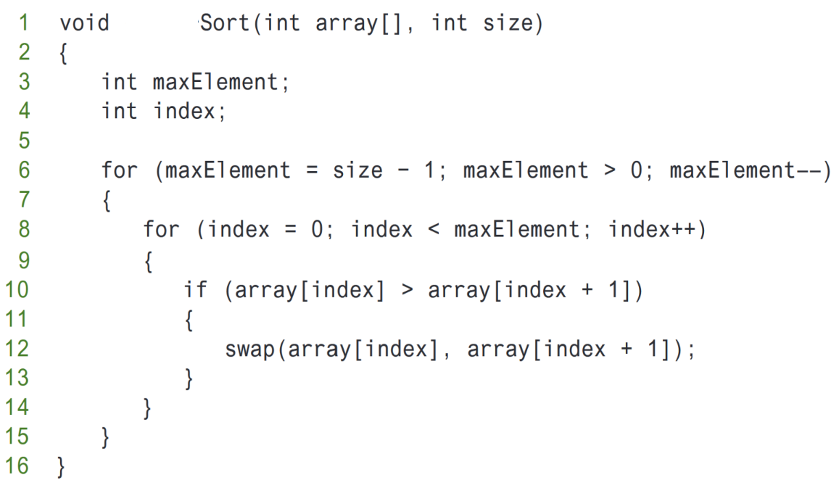
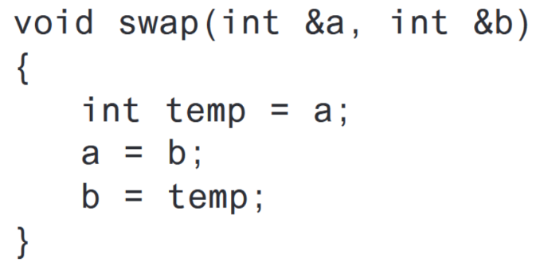
Practice Question (1)
Dry run the code and show output after every iteration of the outer loop:
int array[ ] = {45, 85, -1, 10, 2};

Slide 30
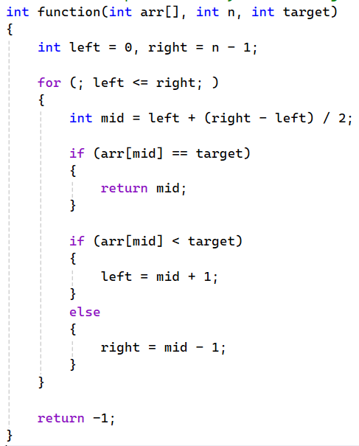
Practice Question (2)
Q: what does this function do?

Slide 31
Practice Question (3)
Q: This algorithm sorts arrays in an ascending order. Change it in a way that it sorts in descending order.

Slide 32
Practice Question (4)

Slide 33
Practice Question (5)
Uploaded on Google classroom

Slide 34
Searching and Sorting Algorithms
Chapter 8, Tony Gadis
Quick recap
Bubble sort: https://www.youtube.com/watch?v=xli_FI7CuzA
Selection sort: https://www.youtube.com/watch?v=g-PGLbMth_g
Sorting Visualizations
https://visualgo.net/en/sorting
https://www.cs.usfca.edu/~galles/visualization/ComparisonSort.html

Slide 35
Any Questions?

